Slide 1

ADAPTIVE, INTERACTIVE DEEP SLEEP ALARM
“IT’S NOT WHAT YOU WANT, BUT IT’S WHAT YOU NEED”
Designed by Carl Vincent Cuyos
Programmed by Austin Yen, Theodore Ikehara
Image taken from Google

Slide 2
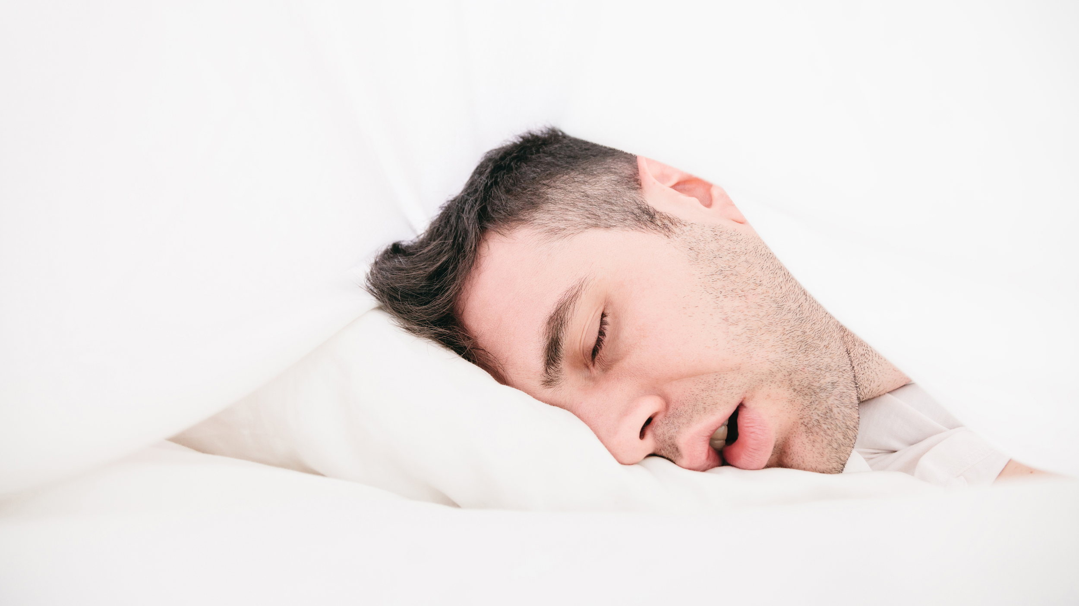
PROBLEM:
Difficulty in removing person from the state of deep sleep.
Image taken from Google
Notes:
oversleeping has been linked to a host of medical problems, including diabetes, heart disease, and increased risk of death.
Linked to people who are under depression and low socioeconomic status

Slide 3
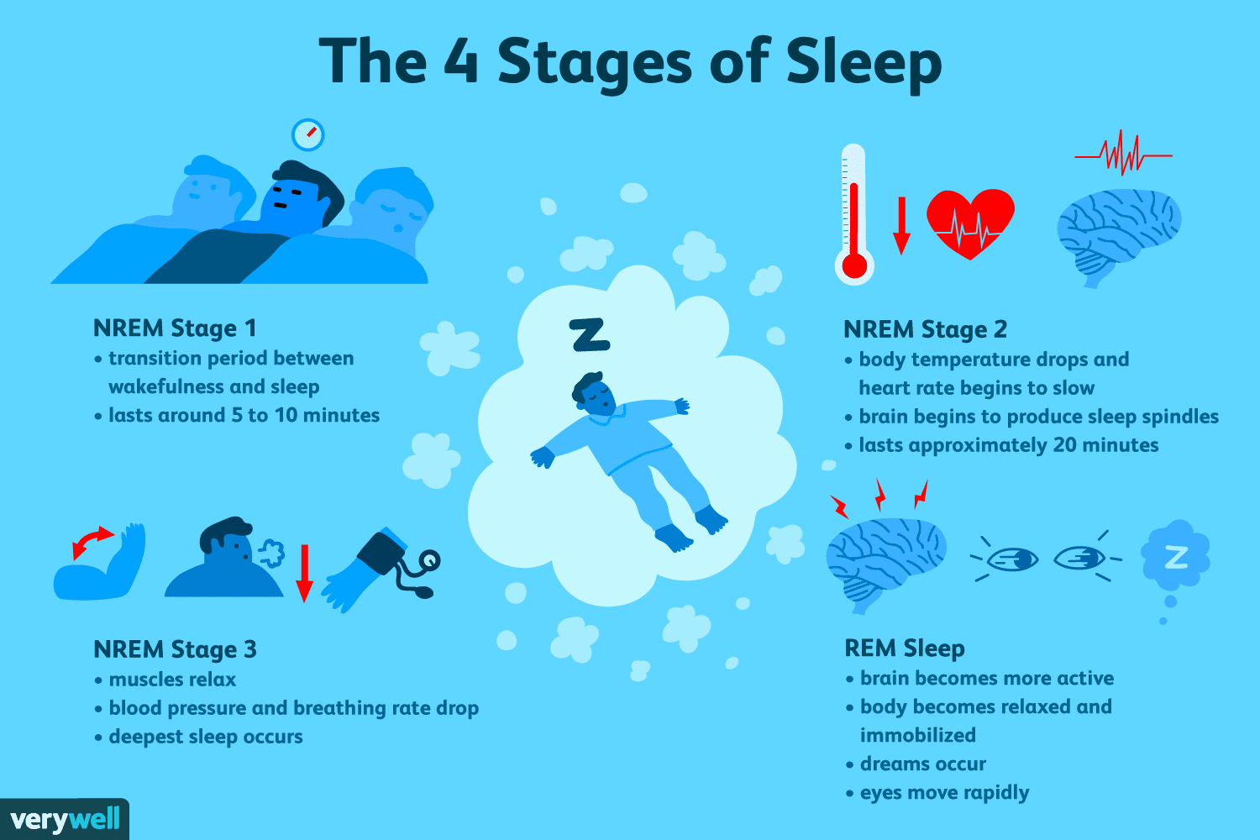
OBJECTIVE:
In order to remove a person from oversleeping and encouraging them to wake up at healthier times
Image taken from Google

Slide 4
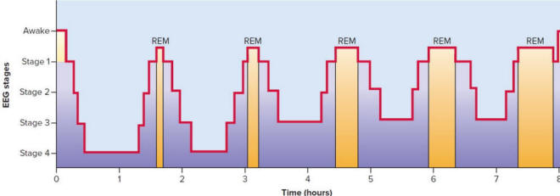
DESIGN REQUIREMENTS:
Variety of Music depending on the person’s REM cycle
Program Suggestion for Healthy waking times
Ask for the user’s input on when to set up their alarm
Provides feedback to what type of music will be played to wake up
Image taken from Google

Slide 5
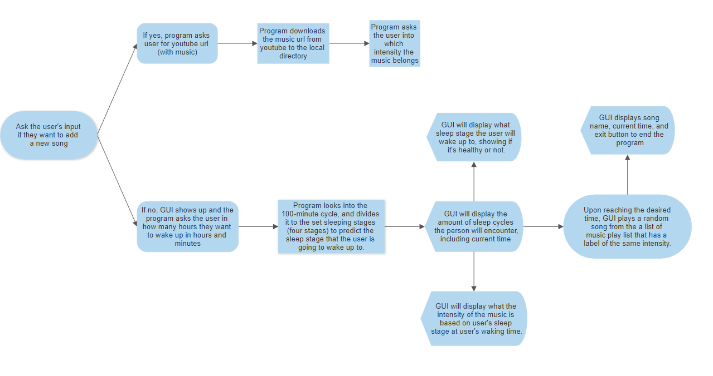
EXPLAINING THE PROGRAMMING
GUI
Importing Music Files
REM Prediction Sleep Cycle Algorithm
Image taken from Google

Slide 6
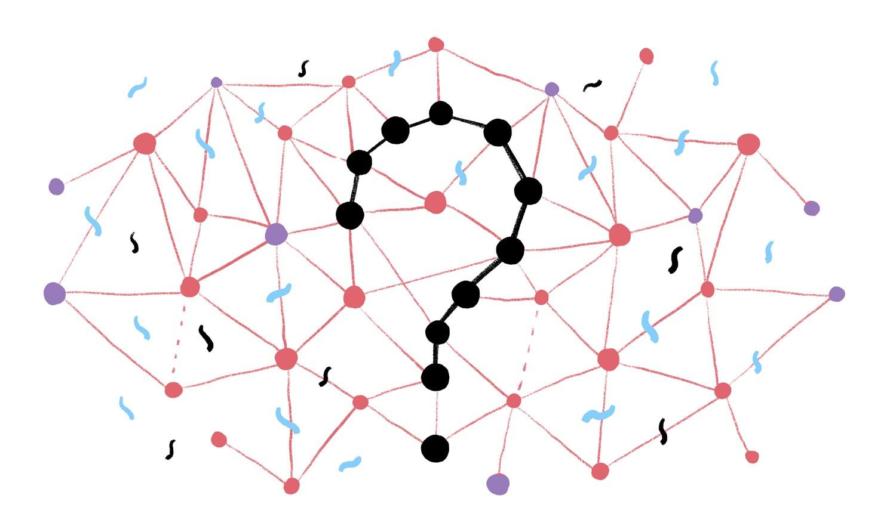
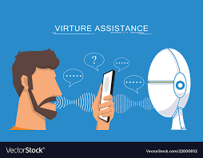
PROBLEMS/FLAWS
Algorithm of Calculating of Sleeping Stage
Incorporating a Voice Recognition System
Image taken from Google
Image taken from Google

Slide 7

TESTING
Upon testing this to ourselves, the program correctly predicted when our sleep cycle would have been during our desired waking time.
It correctly played the right music that we needed for it to play with the correct intensity.
Image taken from Google

Slide 8


FUTURE DEVELOPMENTS
Voice Recognition
Implementation of Code to website/application
Friendlier version of GUI (more focused in moving to application development)
Image taken from Google
Image taken from Google

